Slide 1
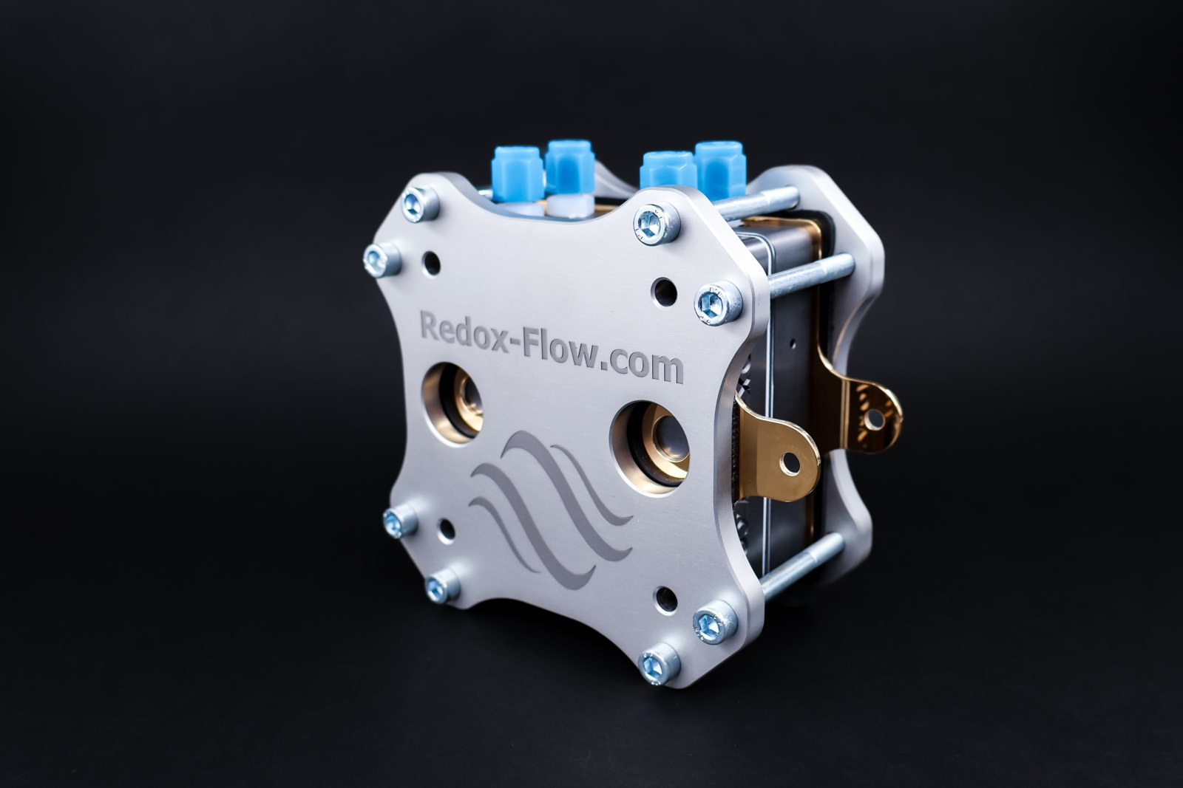

FLOW CELLS · STACKS · TEST SET-UPS
Lab equipment for electrochemistry in flow
For redox flow battery, electrolysis, CO₂ electrolysis and electrodialysis research. Designed and built in Denmark since 2018.
Presented by [Partner name], authorised distributor in [territory]
Notes:
Introduce yourself and your company first, then Redox Flow. One line is enough: Redox Flow is a Danish company that designs and builds flow cells, stacks and complete test set-ups for electrochemistry R&D. We are their authorised partner in [territory], so you get local sales, support and service.

Slide 2
WHO WE ARE
Started from a PhD project. Built for researchers, by researchers.
Redox Flow began when a PhD project showed that flow cell research needed modular hardware. Today we design and build cells, stacks and complete set-ups in Denmark, and ship them to labs around the world.
2018
1,000+
4
Founded in Denmark
Customers worldwide
Main research areas: flow batteries, electrolysis, CO₂ electrolysis, electrodialysis
Notes:
The key message: this is specialist hardware made by researchers, for researchers. Mention one or two institutions from the list that your customer will know, ideally from your own country. If you have local customers using Redox Flow, name them here instead.

Slide 3
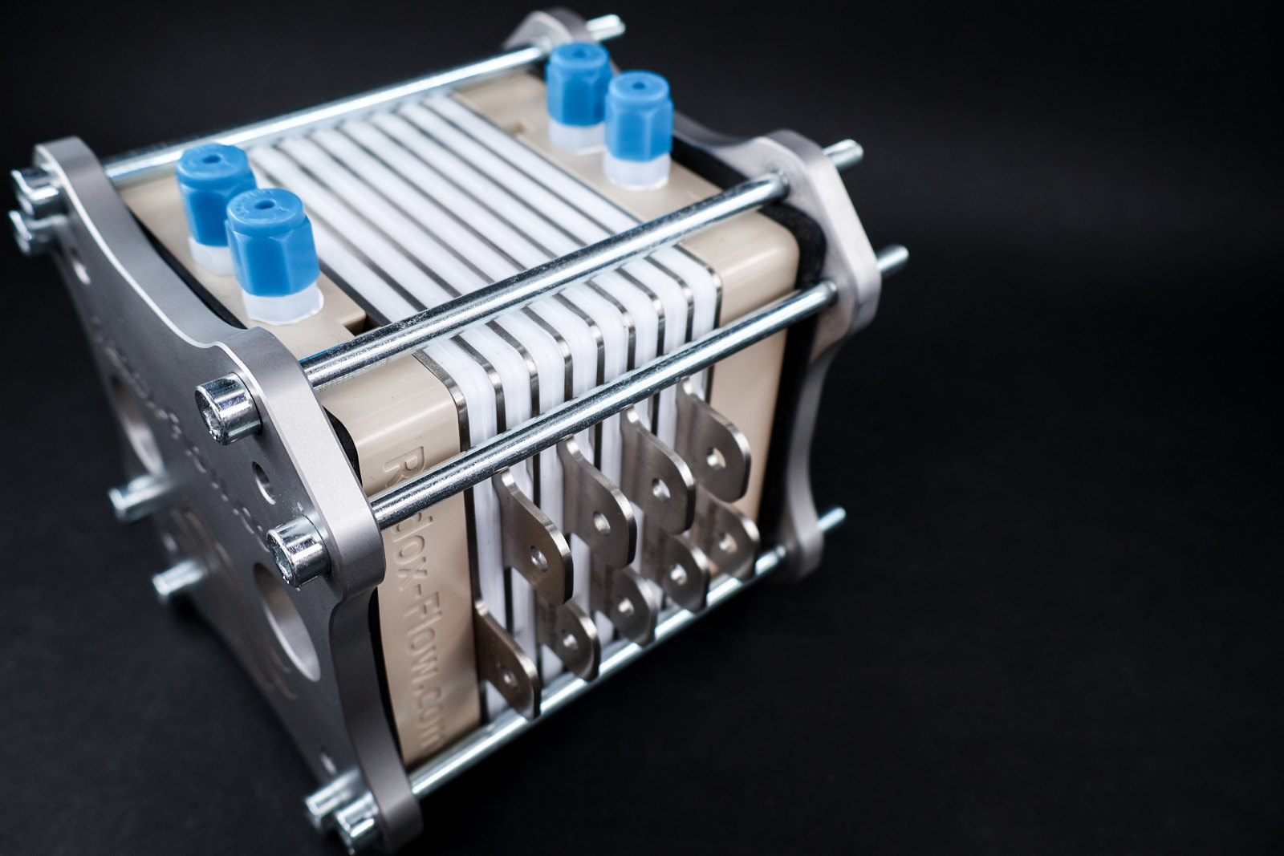
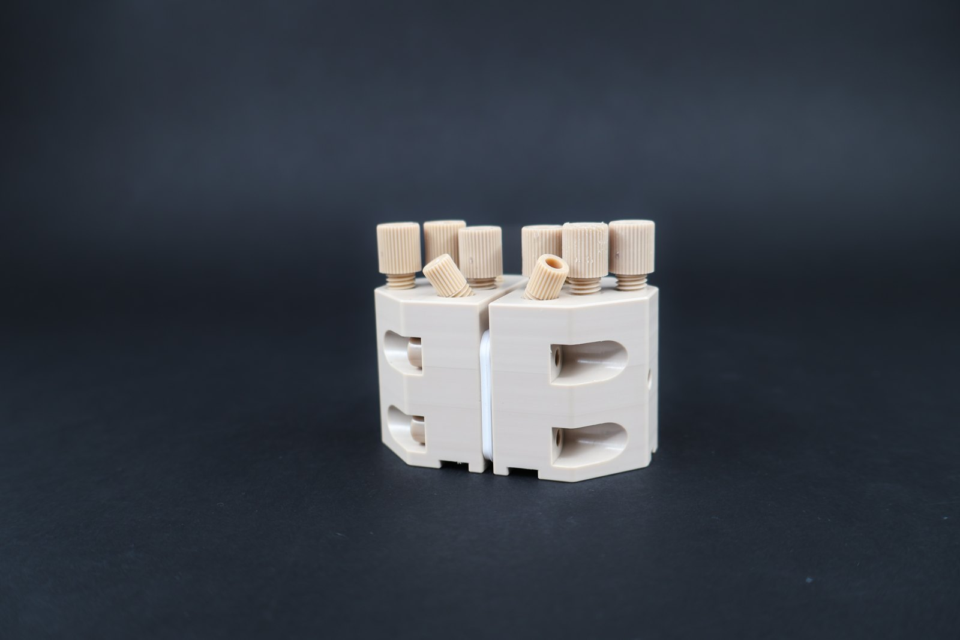
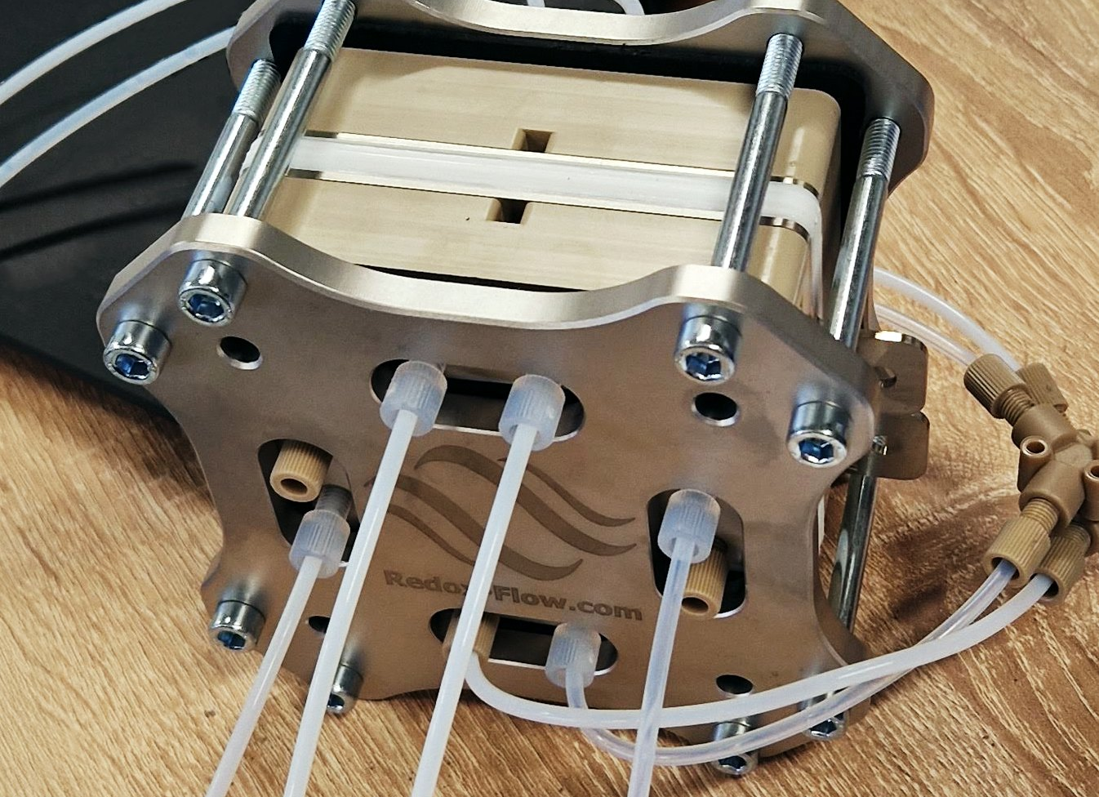
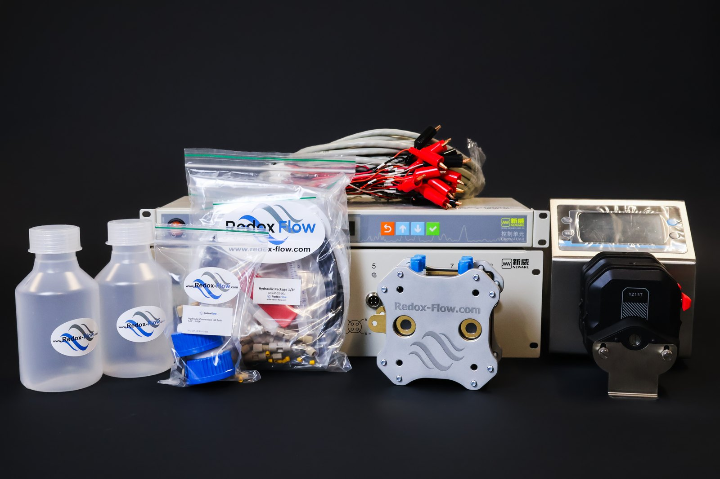
PRODUCT RANGE
One modular range, from test cell to complete set-up
Flow battery
Electrolysis
Multipurpose
Electrodialysis
Complete set-ups
A-Cell, S-Cell, S-Stack
X-Cell, X-Cell with ports, X-Cell with 3–4 compartments, X-Stack
M-Cell Full, M-Cell Half
Y-Cell
Flow battery, electrolysis
New redox couples, membranes and electrodes
1 cm² cell for many set-ups in one platform
Electrodialysis research
Cell, pump, hydraulics and control, ready to run
AEM, PEM, alkaline and CO₂ electrolysis
Plus accessories and consumables: pumps, temperature control, gas separation, UV/VIS and OCV cells, electrode holders, gaskets and more.
Notes:
Ask what the customer is working on before you go into detail, then point to the matching family. The brochures for each cell are in the distributor package if they want the technical specifications. Complete set-ups suit groups that are new to flow cells or want to start quickly.

Slide 4


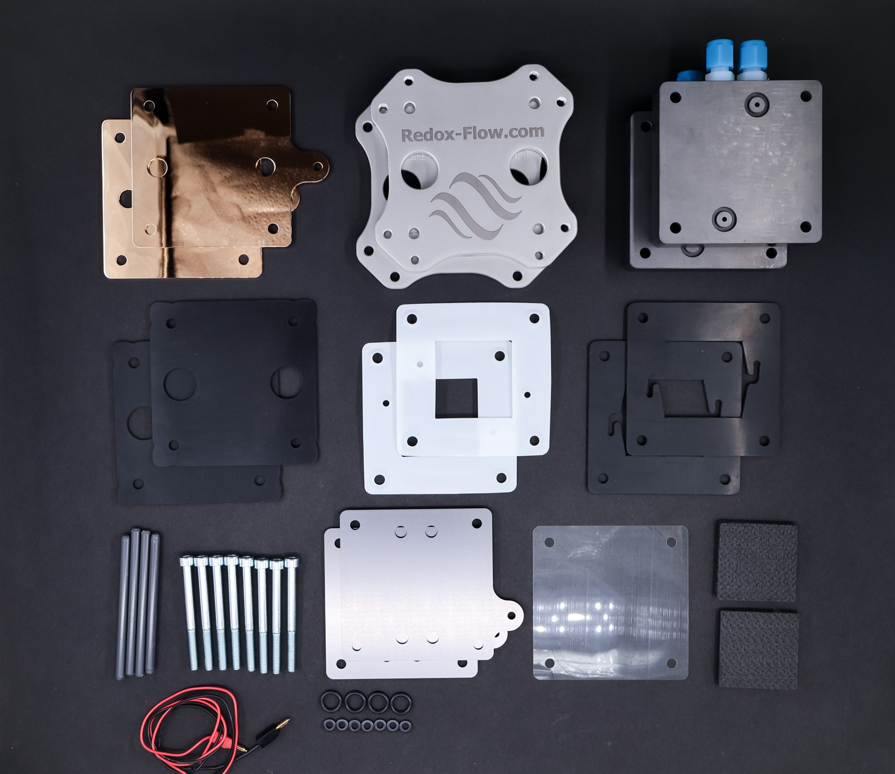


WHY REDOX FLOW
One cell can do a lot
Modular
Ready to run
Parts fit across the range. Swap a few components to change chemistry, or add parts to turn a cell into a stack.
Complete set-ups arrive with cell, pump, hydraulics, control unit, fittings and gaskets.
Custom builds
Robust
Serpentine flow fields, BMED cells, custom gaskets. From small tweaks to full custom designs.
PEEK, PTFE, EPDM and Viton parts for aggressive electrolytes, at temperatures up to 95 °C.
Notes:
The main selling point is modularity: customers can change chemistry or scale up without buying a new cell, and parts are compatible across the range. Mention custom builds if the customer has an unusual geometry or material. The 95 °C figure is from the M-Cell and X-Cell brochures; check the brochure for the specific cell before quoting it.

Slide 5
NEXT STEPS
Let’s find the right set-up for your lab
1
Tell us about your research
Chemistry, active area, materials and budget
YOUR LOCAL CONTACT
2
Get a recommended configuration
[Partner name]
Cell, accessories and consumables that fit
[Contact person]
[email]
[phone]
3
Quote and delivery
In local currency, from your local partner
4
Commissioning and support
Products: redox-flow.com
Manuals: redox-flow.com/brochures-manuals
Videos: youtube.com/@redox-flow
Set-up help, spares, warranty and repairs
Notes:
Close by agreeing on step 1: ask for a short description of the planned experiments so you can come back with a configuration and quote. Leave the brochure for the relevant cell. Step 2 is done with support from Redox Flow if needed, so do not hesitate to loop them in for technical questions.

